Slide 1

A synopsis Report on
A Blog Website with Okta Authentication
Submitted in partial fulfillment of requirements for the award of degree in
DEPARTMENT OF COMPUTER APPLICATIONS
OF BENGALURU CITY UNIVERSITY
BENGALURU
Submitted by :-
ANUBHAV LAL (R1920620)
&
NEHAL DEB (R1920689)
DEPARTMENT OF COMPUTER APPLICATIONS
ACHARYA INSTITUTE OF GRADUATE STUDIES
(NAAC Re-accredited with ‘A’ Grade)
#89/90, Soldevanahalli, Hesaraghatta road, Bengaluru 560107
2021-2022

Slide 2
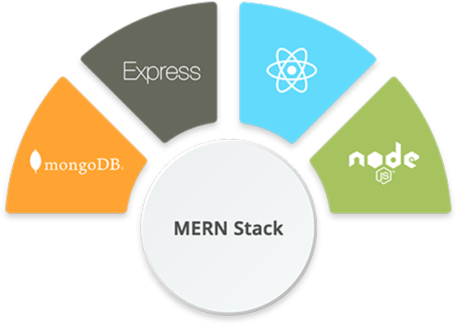
ABSTRACT
Title :- The Blogging
“The Blogging” is a web based project/application for students of Acharya Institute. The main objective of this project is to bridge the gap between the students studying in the same college. Through the blogs which are only accessible by students of their own college, they can freely share creative ideas, thoughts and express their opinions on any topic of their liking.
This is an exclusive blog website where only the users with acharya email address can access the website. It will be updated with new information on an ongoing basis. It normally consists of a collection of posts. Posts may be short, informal, controversial, or more professional. Blogs can be updated consistently and provides the option for readers to comment or ask questions on individual posts. This means that readers can engage with the blog posts writer in a different way than they are the main site pages.
It will be a MERN stack application which uses ReactJS with Material-UI (framework) for the front end styling and in the back-end NodeJS with ExpressJS (framework) is used. The data is stored on a serverless database called MongoDB.

Slide 3
MODULES
Login :- This is the default page where the user has to enter the valid credentials to access the website.
User :-
Can sign in
Can create a blog with image, title and content
Can delete or update their previous blog’s title, image and content
Can comment their opinion and thoughts on other people’s blog.
SYSTEM REQUIREMENTS :
Hardware Specifications :
HDD : 40GB
RAM : 2GB
Processor : i 3 or higher
Keyboard
Mouse
Software Specifications :
Technology : JavaScript, HTML, CSS
Client Side : ReactJS, Material-UI ( Framework )
Server Side : NodeJS, ExpressJS ( Framework )
Database : Mongo DB
OS : Windows 8 or higher & Linux
Browser : Google Chrome

